Slide 1


Opening the black box of carbon degradation pathways in marine sediments through single cell genomics and metagenomics
Karen G. Lloyd
C-DEBI network talk July 25, 2013
University of Tennessee, Knoxville

Slide 2
Q: What drives microbial diversity in the vast marine subsurface?

Slide 3
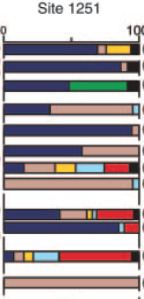
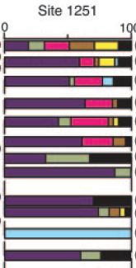
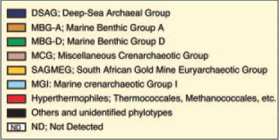
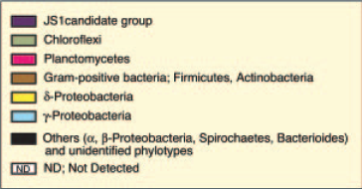
Archaea
Bacteria
Sulfate reducers
ODP Shipboard Data
Inagaki et al. 2006, PNAS

Slide 4
Q: What drives microbial diversity in the marine subsurface?
A1. Not the terminal electron acceptor (sulfate, iron, manganese, CO₂)

Slide 5
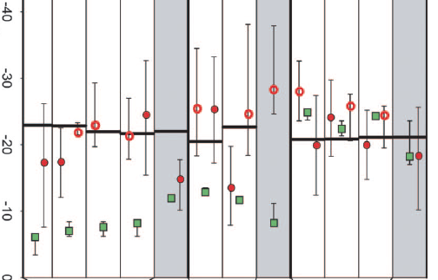
Archaeal biomass comes from Organic Matter (vertical lines), not Inorganic carbon
δ¹³C
Different subusrface samples
Biddle et al. 2006, PNAS

Slide 6
Q: What drives microbial diversity in the marine subsurface?
A1. Not the terminal electron acceptor (sulfate, iron, manganese, CO₂)
A2. Most likely organic matter

Slide 7
Archaea
Bacteria
ODP Shipboard Data
Inagaki et al. 2006, PNAS

Slide 8
Q: What types of organic matter are available as substrates?

Slide 9
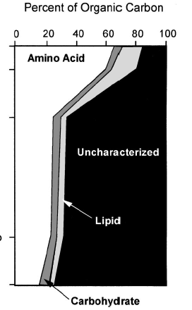
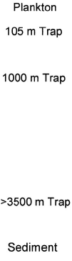
Most organic matter is chemically uncharacterized
“Biogeochemists of today are playing with an extremely incomplete deck of surviving molecules, among which most of the trump cards that molecular knowledge would supply remain masked.”
Lignin
Black Carbon (left over from fires)
Hedges et al. 2000 Org. Geochem. (After Wakeham et al. 1997 GCA)

Slide 10
Q: What types of organic matter are available as substrates?
A. Proteins, carbohydrates, lipids, lignin, and a bunch of mysterious compounds.

Slide 11
Q: How do protein, carbohydrate, and lipids create diverse physiological niches?

Slide 12
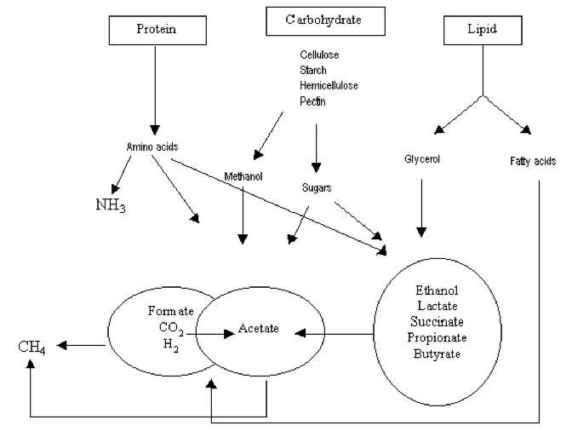
Fermentation of organic matter
Extracellular enzymes and abiotic processes
Primary intracellular fermentation
Terminal respiration
Secondary intracellular fermentation
Centre for Ecological Sciences, IISc, Bangalore

Slide 13
Q: How do protein, carbohydrate, and lipids create diverse physiological niches?
A: There are thousands of biochemically characterized extracellular and intracellular enzymes with different substrate specificities, acting at different points in the fermentation cascade, and requiring different chemical conditions. So, maybe by examining the range of enzymes available to an organism, we can discover its organic matter niche.

Slide 14
Single cell genomics: A way to put together large genomic fragments of a single uncultured organism, to connect “who” to “what” they’re doing

Slide 15
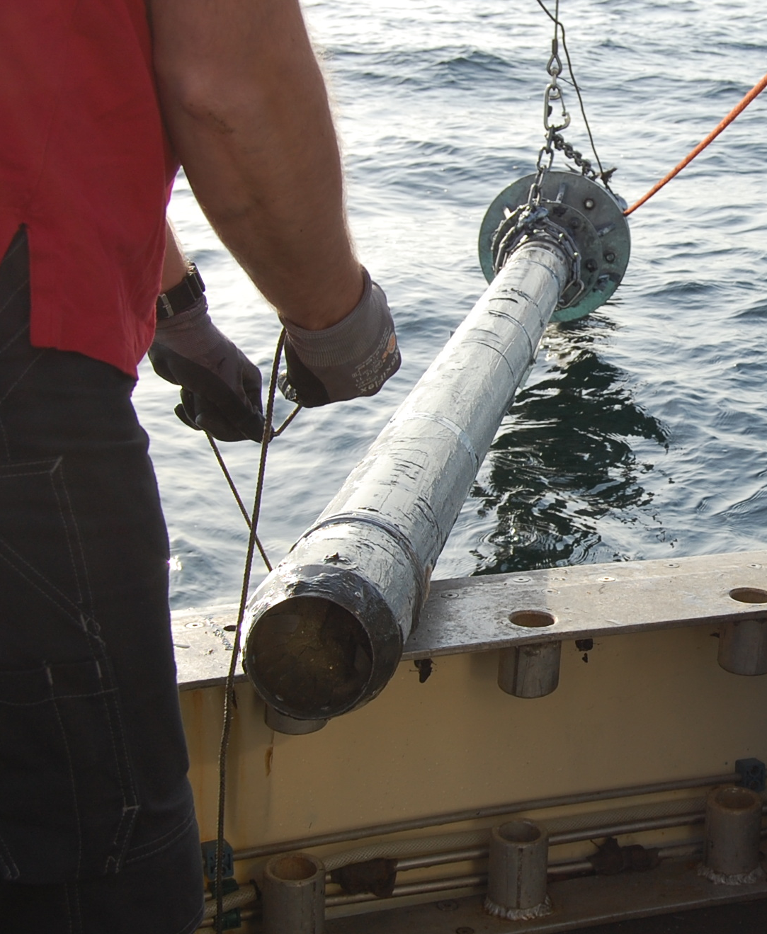

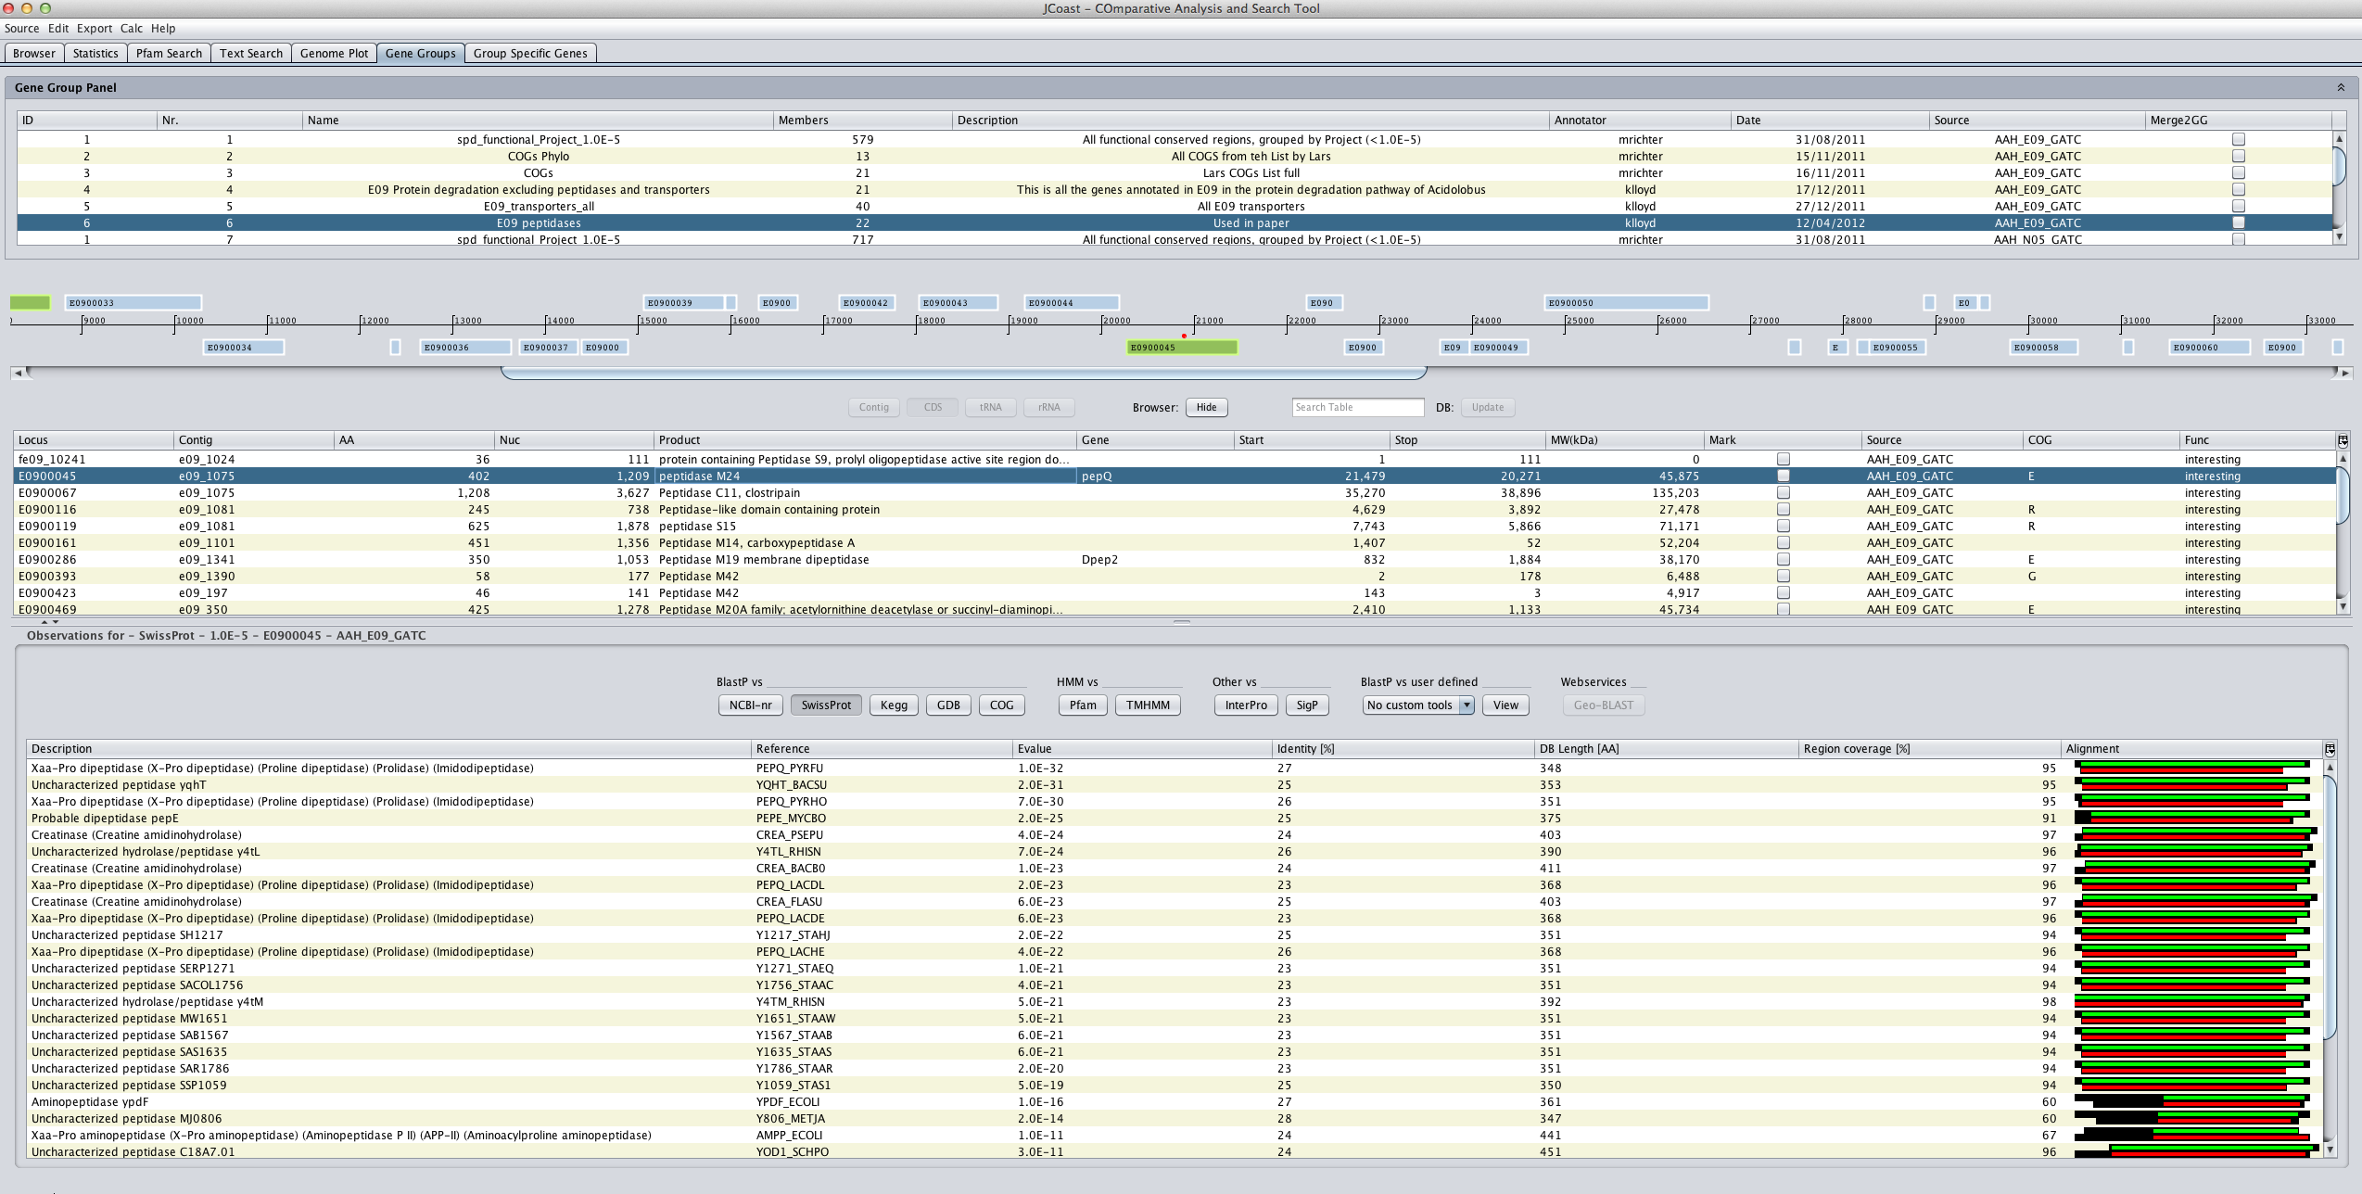
Getting a genome from a single environmental cell
Collect sediment
Extract cells from
Sediments and store in glycerol
Single Cell Genomics Center (Bigelow Institute for Ocean Sciences)
Stain cells with Syto9
FACS to sort into 384-well plate
Lysis and 1st whole genome amplification
16S rRNA gene PCR and sequencing
2nd whole genome amplification
cells
sediment
10 cm, Aarhus Bay,
Denmark
Ribocon (Max Plank Institute for Marine Microbiology)
Gene calling
Annotation
Jcoast database
GATC Biotech
Illumina
454
Genome
Assembly with CLC, Velvet, Newbler, AMOS
Quality control
Detailed Gene Homology Genome analysis

Slide 16
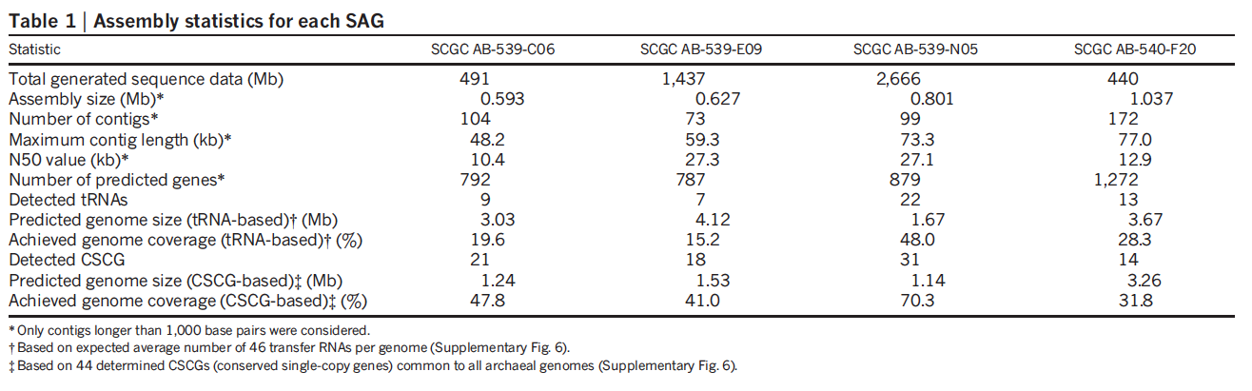
We caught cells from archaea with worldwide distribution and can be the dominant cells (by FISH and qPCR) in some marine sediments (Kubo et al. 2012, ISME J).
We retrieved only 15-70% of each genome, but that’s a lot more than 0%!
MBG-D
MCG
MBG-D
MBG-D
Lloyd et al. 2013, Nature

Slide 17
Q: How do we find genes relevant to the degradation of proteins, lipids, and carbohydrates in these genomes?

Slide 18
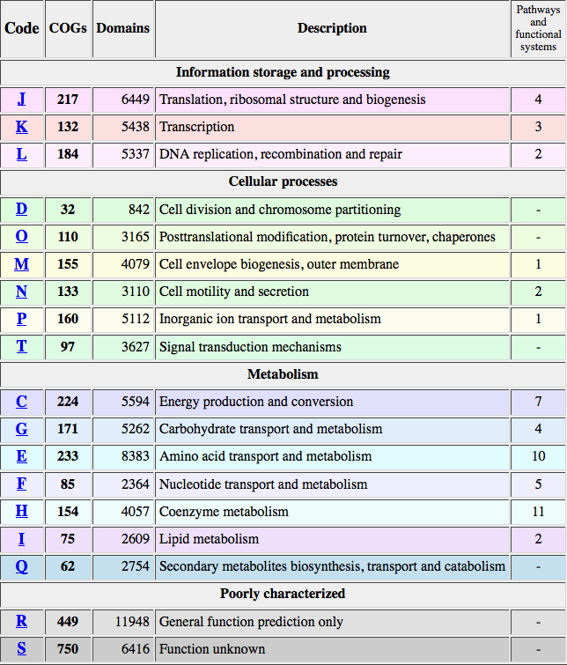
Clusters of Orthologous Genes (COGs) provide very general functional descriptions
NCBI website

Slide 19
Q: How do we find genes relavent to the degradation of proteins, lipids, and carbohydrates in these genomes?
A: Step 1. Use COGs, Pfams, Tigrfams, SEED,
Swissprot/Uniprot, Genbank, Kegg to annotate
predicted genes.
Step 2. Conduct “detailed gene homologue
analysis”, where experimentally-determined traits
of nearest gene homologue are used to
hypothesize functions in predicted genes.

Slide 20
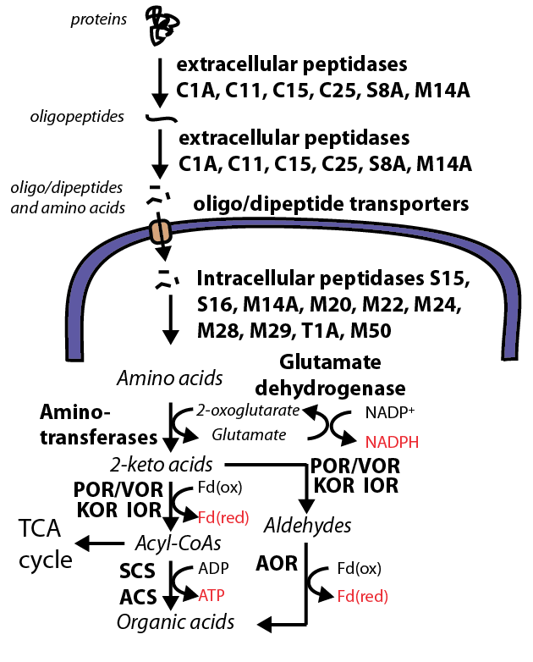
Gene homologues of these cysteine petpidases are all extracellular, and degrade proteins/peptides for cellular nutrition in bacteria.
They require high Ca²⁺ concentrations and anoxic conditions to be functional – perfect for the deep subsurface!
Lloyd et al. 2013, Nature

Slide 21
Lloyd et al. 2013, Nature

Slide 22
Lloyd et al. 2013, Nature

Slide 23
Lloyd et al. 2013, Nature

Slide 24
In a meta-genome, these would be correctly annotated as archaea
Lloyd et al. 2013, Nature

Slide 25
In a meta-genome, these would be wrongly annotated as bacteria!
In a meta-genome, these would be correctly annotated as archaea
Lloyd et al. 2013, Nature

Slide 26
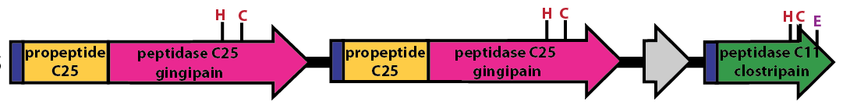
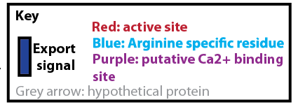
These cysteine peptidases have intact functional groups, extracellular transport signals, and cofactor binding sites.
They also occur in clusters on the genome.
Lloyd et al. 2013, Nature

Slide 27
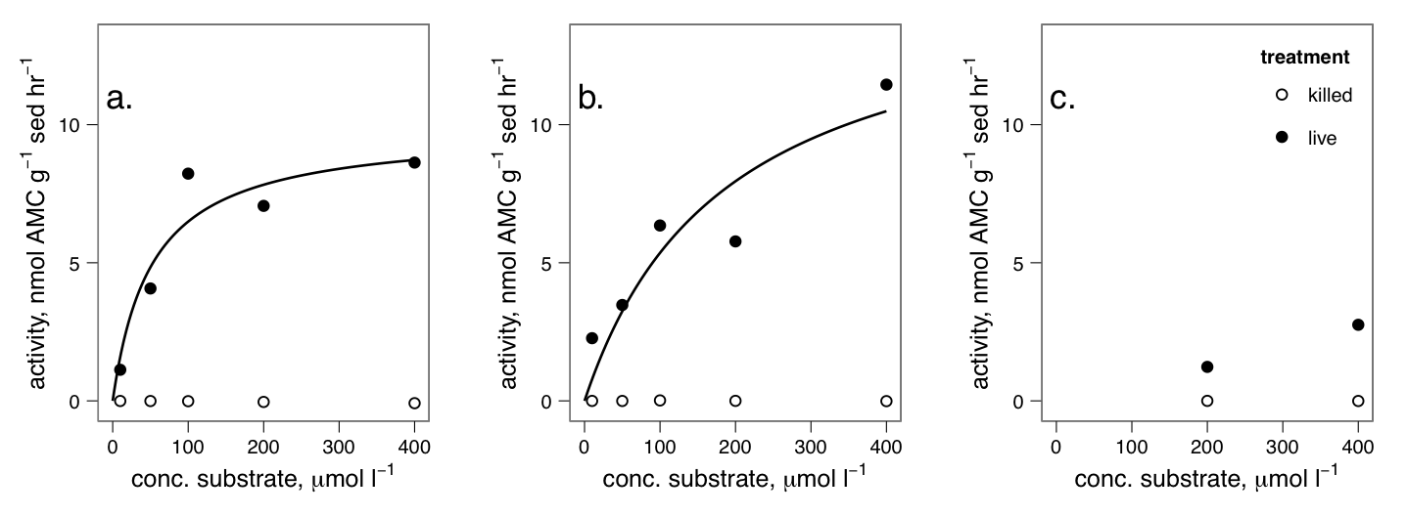
The substrates of these cysteine peptidases are readily hydrolyzed in Aarhus Bay sediments.
Leucyl- aminopeptidase
C25
C11
Lloyd et al. 2013, Nature

Slide 28
Conclusions:
Some subsurface archaea degrade detrital proteins using extracellular enzymes that prefer cleaving at arginine and have special adaptations to the anoxic subsurface environment.
“Detailed gene homologue analysis” is an effective way to discover OM degrading gene pathways.

Slide 29
What about the rest of the subsurface microbial community?

Slide 30
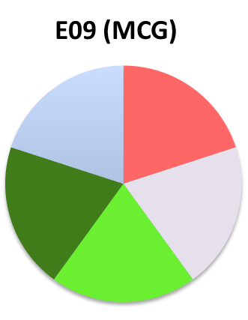
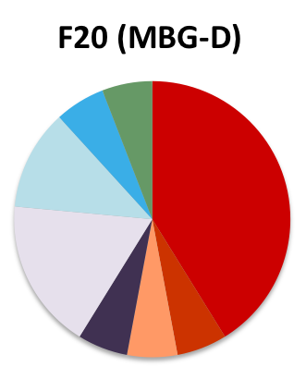
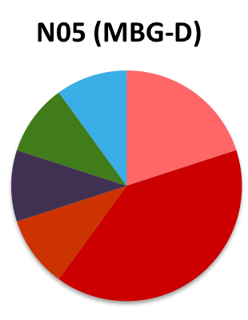
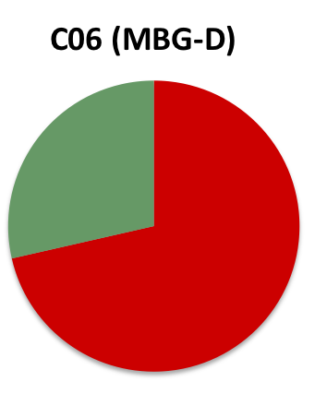
Digestive peptidase diversity in single cells
Archaea
Shades of red = cysteine peptidases, shades of green/blue = metallopeptidases, shades of purple = serine peptidases

Slide 31
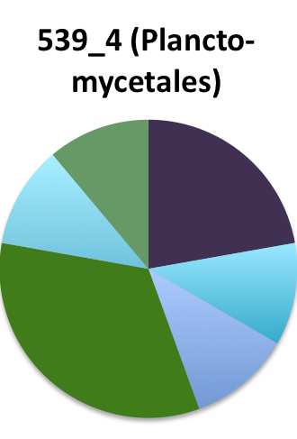
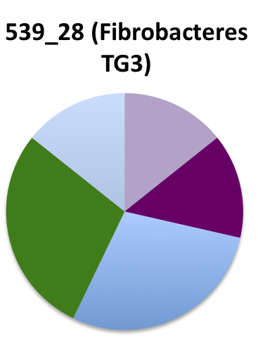
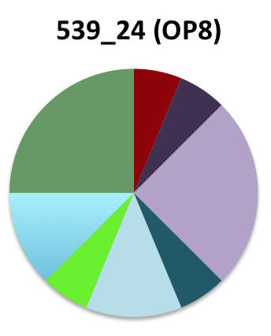
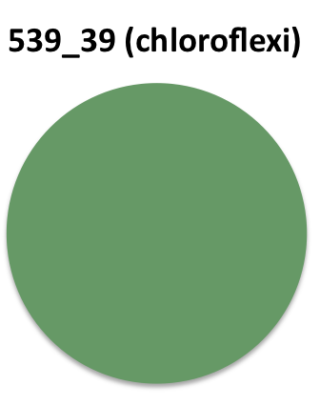
Digestive peptidase diversity in single cells
Archaea
Bacteria
Shades of red = cysteine peptidases, shades of green/blue = metallopeptidases, shades of purple = serine peptidases

Slide 32
What about the rest of the subsurface microbial community?
A1: So far, archaea have more cysteine peptidases (cleave at arginine or proline, all require strict anoxic environment) and bacteria have more metallopeptidases (cleave at leucine or proline, or cell wall degradation for predation).

Slide 33
What about the rest of the subsurface microbial community?

Slide 34
Analyzed the following from IMG database:
86 water metagenomes (deep N. Atlantic and shallow Delaware Bay)
12 sediment methane seep metagenomes (Santa Barbara Basin and Arctic Ocean)

Slide 35
Analyzed the following from IMG database:
86 water metagenomes (deep N. Atlantic and shallow Delaware Bay)
12 sediment methane seep metagenomes (Santa Barbara Basin and Arctic Ocean)
Seawater has a bunch of peptidases for viruses, eukaryotes, growth, intercellular communication, and digestion that are less represented in sediments

Slide 36
Analyzed the following from IMG database:
86 water metagenomes (deep N. Atlantic and shallow Delaware Bay)
12 sediment methane seep metagenomes (Santa Barbara Basin and Arctic Ocean)
Microbes in sediments and seawater seem to use very different peptidases for nutrition (OM degradation) as well as sporulation, antibiotic responses, and housekeeping.

Slide 37
What about the rest of the subsurface microbial community?
A2: They might be using different enzymes than seawater organisms to degrade organic matter. So, sediments may differ from seawater not just in speed of OM degradation, but in quality.

Slide 38
What organisms are responsible for the potentially OM degrading enzymes (blue pie wedges)? Do we have them in our single cells?

Slide 39
Digestive peptidase over-represented in sediments
Archaea
Bacteria
Shades of red = cysteine peptidases, shades of green/blue = metallopeptidases, shades of purple = serine peptidases

Slide 40
What about the rest of the subsurface microbial community?
A3: Half of the potentially OM-degrading peptidases that were over-represented in sediment metagenomes were present in our single cells, and were found in either only archaea, or both archaea and bacteria. So, our single cells might actually be descriptive of the larger community, and archaea and bacteria both have sediment-specific peptidases.

Slide 41
The peptidase that is the most over-represented in sediments (C69) increases relative to total metagenomic reads with sediment depth in both samples. Is this the first true deep subsurface peptidase?
Analysis by Andrew Steen

Slide 42
Directions for the immediate future:
Deeper sediments
More peptidase trends with depth and environments
Carbohydrates and lipids
Create an OM degradation database tool for other researchers to use

Slide 43
Biochemical and Ecological Analysis Tool for OM degradation
metagenome processor
R app w/ web-based GUI
Curators:
populate database using publicly available data
Community:
refine database using primary literature & research results
Product
Relative abundance and putative function of peptidases in metagenome
Depth/location trends of genes (at various levels of classification)
Easy comparison with previously-published metagenomes
wiki database
OM degradation function
enzyme

Slide 44






Thank you!
Aarhus University: Lars Schreiber, Dorthe Petersen, Kasper Kjeldsen, Mark Lever, Andreas Schramm, Bo Barker Jorgensen
Max Plank Institute for Marine Microbiology in Bremen, Germany: Michael Richter, Sara Kleindeinst, Sabine Lenk
Bigelow Institute for Ocean Sciences: Ramunas Stepanauskas, Wendy Bellows, Jochen Nuester
University of Tennessee: Andrew Steen, Jordan Bird
91671401-0

